Slide 1



Session 1
Cyber Fundamentals - Authentication Basics

Slide 2
Learning Outcomes :
Explain how authentication measures protect devices and information from unauthorized
access.
Explore common authentication methods (passwords, biometrics, tokens).
Introduction to authentication methods and their role in cybersecurity.

Slide 3
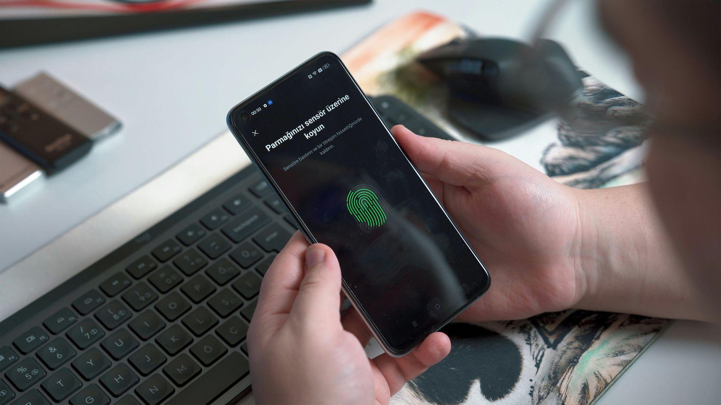
Understanding the term “ AUTHENTICATION IN CYBERSECURITY “ :
Within the field of cybersecurity, authentication specifically denotes the action of proving the identity of a user, device or system prior to the access to networks, applications or data resources. One objective of authentication is to restrict access to sensitive information or actions to authorized individuals or entities only.
There are three common types of authentication factors:
Something you know – for instance a password or a PIN,Pattern
Something you have – this may include a smart card, security token, or a mobile device.
Something you are – like biometrical parameters (fingerprint, facial features and voice patterns).
Frequently, systems employ multi-factor authentication (MFA) systems which incorporate two or more of the described factors to improve security. For instance, it is possible to be required to enter a password (something you know) and scan a fingerprint (something you are) in a single system.
Amidst the floods of cyberspace, authentication is one of the most important parts of providing security and privacy.

Slide 4
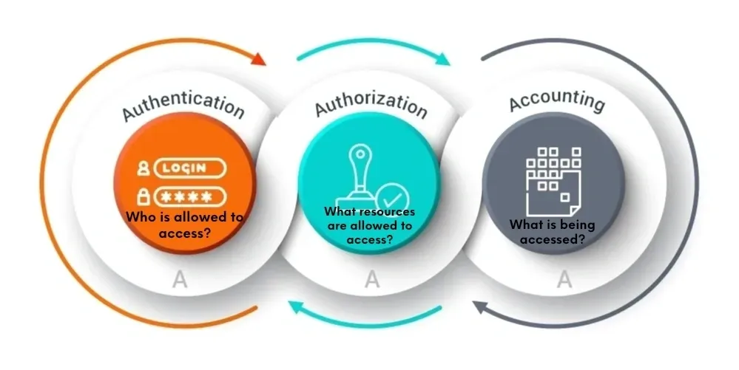
Importance of Authentication in Cybersecurity
Overview:
Authentication plays a critical role in cybersecurity by acting as the first line of defense against unauthorized access to sensitive systems and data.
It ensures that only legitimate users or systems are granted access, preventing data breaches, unauthorized data modification, and cyberattacks.

Slide 5

Why Authentication is Important?
Authentication is a critical aspect of cybersecurity because it ensures that only authorized users can access sensitive data, systems, and networks. By verifying a user’s identity, authentication prevents unauthorized access and helps protect confidential information from theft, fraud, or exposure. It serves as the first line of defense against malicious actors attempting to impersonate legitimate users, mitigating risks like data breaches and cyber
attacks.Moreover, authentication is essential for compliance with regulatory frameworks and supports accountability by creating audit trails of user activity. It helps organizations prevent both external and internal threats, ensuring that only those with proper authorization can access specific resources. Multi-factor authentication (MFA) adds an extra layer of security, making it more difficult for attackers to gain unauthorized access even if credentials are compromised.

Slide 6
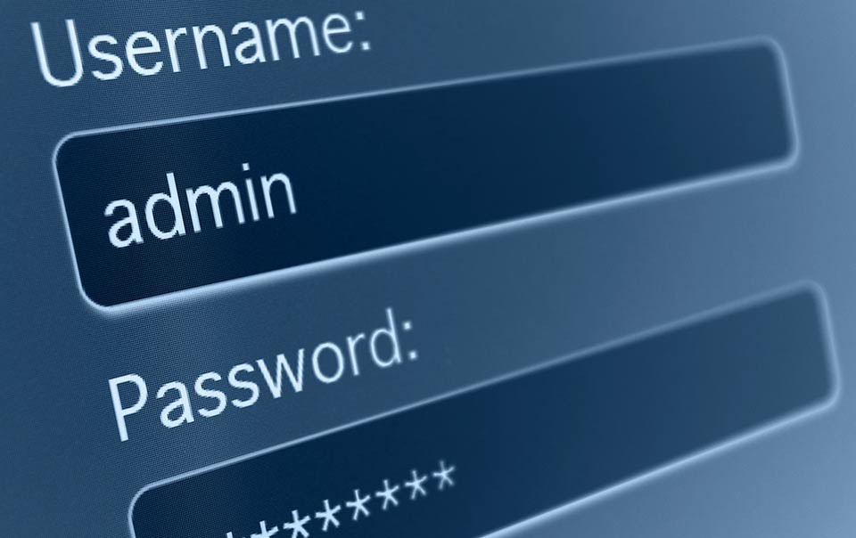
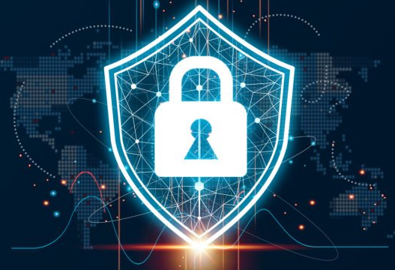
5 Common Authentication Types
1. Password-based authentication
Passwords are the most common methods of authentication. Passwords can be in the form of a string of letters, numbers, or special characters. To protect yourself you need to create strong passwords that include a combination of all possible options.
However, passwords are prone to phishing attacks and bad hygiene that weakens effectiveness. An average person has about 25 different online accounts, but only 54% of users use different passwords across their accounts.
The truth is that there are a lot of passwords to remember. As a result, many people choose convenience over security. Most people use simple passwords instead of creating reliable passwords because they are easier to remember.
The bottom line is that passwords have a lot of weaknesses and are not sufficient in protecting online information. Hackers can easily guess user credentials by running through all possible combinations until they find a match.

Slide 7
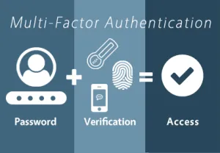
5 Common Authentication Types
2. Multi-factor authentication
Multi-Factor Authentication (MFA) is an authentication method that requires two or more independent ways to identify a user. Examples include codes generated from the user’s smartphone, Captcha tests, fingerprints, voice biometrics or facial recognition.
MFA authentication methods and technologies increase the confidence of users by adding multiple layers of security. MFA may be a good defense against most account hacks, but it has its own pitfalls. People may lose their phones or SIM cards and not be able to generate an authentication code.

Slide 8
5 Common Authentication Types
3. Certificate-based authentication
Certificate-based authentication technologies identify users, machines or devices by using digital certificates. A digital certificate is an electronic document based on the idea of a driver’s license or a passport.
The certificate contains the digital identity of a user including a public key, and the digital signature of a certification authority. Digital certificates prove the ownership of a public key and issued only by a certification authority.
Users provide their digital certificates when they sign in to a server. The server verifies the credibility of the digital signature and the certificate authority. The server then uses cryptography to confirm that the user has a correct private key associated with the certificate.

Slide 9
5 Common Authentication Types
4. Biometric authentication:-
Biometrics authentication is a security process that relies on the unique biological characteristics of an individual. Here are key advantages of using biometric authentication technologies:
Biological characteristics can be easily compared to authorized features saved in a database.
Biometric authentication can control physical access when installed on gates and doors.
You can add biometrics into your multi-factor authentication process.
Biometric authentication technologies are used by consumers, governments and private corporations including airports, military bases, and national borders. The technology is increasingly adopted due to the ability to achieve a high level of security without creating friction for the user. Common biometric authentication methods include:
Facial Recognition: Matches unique facial features to grant access. It can be inconsistent with different angles or similar-looking individuals. Facial liveness (e.g., ID R&D’s passive liveness) prevents spoofing.
Fingerprint Scanners: Identifies users by fingerprint patterns, including newer versions that analyze vascular patterns. Despite occasional inaccuracies, they are popular, especially in smartphones like iPhones.
Speaker Recognition: Analyzes speech patterns for user identification, using specific voice qualities, often relying on set phrases like a password for access.

Slide 10
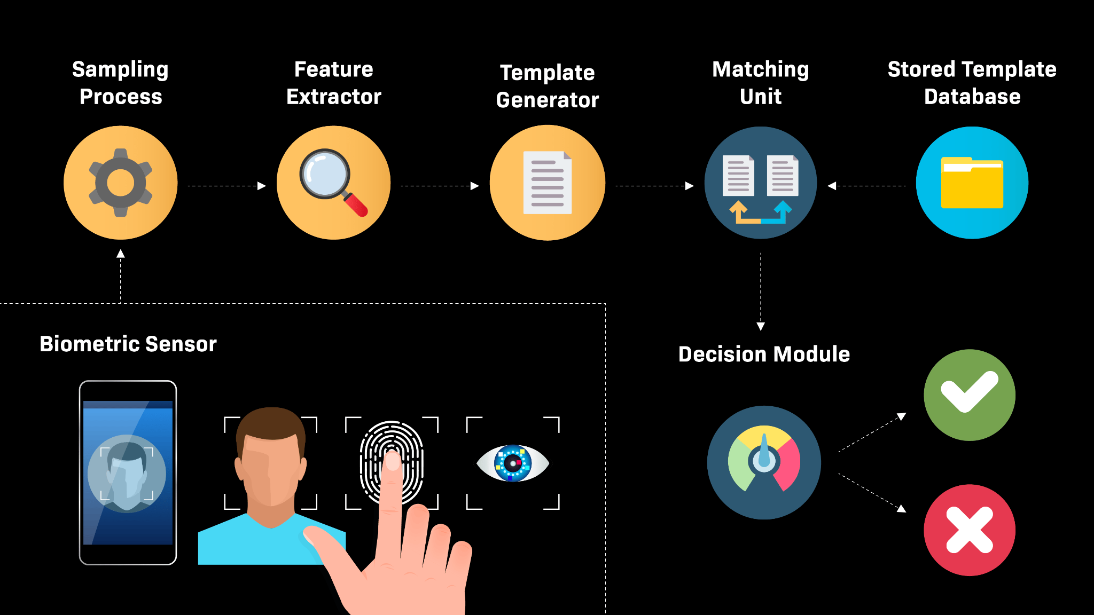

Slide 11
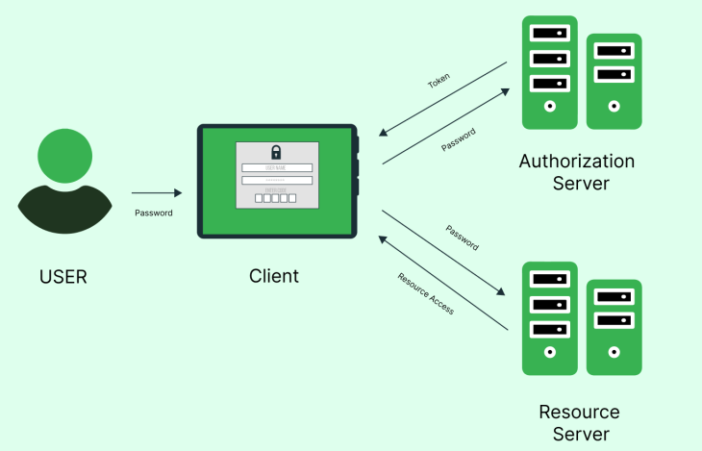
5 Common Authentication Types
5. Token-based authentication
Token-based authentication technologies enable users to enter their credentials once and receive a unique encrypted string of random characters in exchange. You can then use the token to access protected systems instead of entering your credentials all over again. The digital token proves that you already have access permission. Use cases of token-based authentication include RESTful APIs that are used by multiple frameworks and clients.

Slide 12
PYTHON PRACTICAL ACTIVITY ( Code Link )
Practical Activity # 1 (Password Strength Checker)
Practical Activity # 2 ( Multi-Factor Authentication Simulation )
Practical Activity # 3 ( Fingerprint Biometric Mock )
Practical Activity # 4 ( Token-Based Authentication Demo )
Practical Activity # 5 ( Authentication Audit Log Generator )

Slide 13
Practical Activity # 1 (Password Strength Checker)
💡 Demonstrates how strong passwords can protect against brute-force and dictionary attacks.
import re
def check_password_strength(password):
print("\n🔐 Checking password strength...")
if len(password) < 8:
print("❌ Too short! Minimum 8 characters recommended.")
elif not re.search("[A-Z]", password):
print("❌ Add at least one uppercase letter.")
elif not re.search("[0-9]", password):
print("❌ Include at least one number.")
elif not re.search("[!@#$%^&*()_+]", password):
print("❌ Include at least one special character.")
else:
print("✅ Strong password!")
password = input("Enter your password to test: ")
check_password_strength(password)

Slide 14
Practical Activity # 2 ( Multi-Factor Authentication Simulation )
💡 Simulates MFA by combining password and OTP verification.
import random
def generate_otp():
return str(random.randint(100000, 999999))
correct_password = "CyberSecure123!"
print("🔐 Multi-Factor Authentication Simulation")
pwd = input("Enter your password: ")
if pwd == correct_password:
otp = generate_otp()
print(f"Your OTP is: {otp} (simulate this being sent to your phone)")
entered_otp = input("Enter the OTP: ")
if entered_otp == otp:
print("✅ Access granted!")
else:
print("❌ Incorrect OTP. Access denied.")
else:
print("❌ Wrong password. Access denied.")

Slide 15
Practical Activity # 3 ( Fingerprint Biometric Mock )
💡 Mimics how biometric fingerprint matching could be checked.
stored_fingerprints = {
"student1": "ABC123XYZ",
"student2": "JHG456QWE",
}
print("🧬 Biometric Authentication Simulator")
username = input("Enter username: ")
fingerprint = input("Scan fingerprint (enter hash string): ")
if username in stored_fingerprints and stored_fingerprints[username] == fingerprint:
print("✅ Biometric Match! Access Granted.")
else:
print("❌ Biometric Mismatch. Access Denied.")

Slide 16
Practical Activity # 4 ( Token-Based Authentication Demo )
💡 Shows how session tokens replace re-entering passwords
import uuid
def authenticate_user(username, password):
if username == "admin" and password == "admin123":
return str(uuid.uuid4())
return None
print("🔑 Token-Based Authentication")
user = input("Username: ")
pwd = input("Password: ")
token = authenticate_user(user, pwd)
if token:
print(f"✅ Login successful! Your session token is: {token}")
print("Use this token to access further resources securely.")
else:
print("❌ Authentication failed.")

Slide 17
Practical Activity # 5 ( Authentication Audit Log Generator )
💡 Simulates tracking login attempts — shows importance for cybersecurity visibility.
from datetime import datetime
log = []
def login(username, password):
timestamp = datetime.now().strftime("%Y-%m-%d %H:%M:%S")
success = username == "user1" and password == "Secure!456"
log.append(f"{timestamp} | User: {username} | {'Success' if success else 'Failed'}")
return success
print("📝 Authentication Log Simulation")
for _ in range(3):
uname = input("Username: ")
pwd = input("Password: ")
if login(uname, pwd):
print("✅ Login successful.")
else:
print("❌ Login failed.")
print("\n🔍 Authentication Log:")
for entry in log:
print(entry)

Slide 18
Quiz
Now it's time to apply your knowledge! Click the link below to take an interactive quiz in the Streamlit app. This quiz will test your understanding of Authentication Basics and its importance in Information Security.
How to Approach the Quiz:
Understand Authentication: Make sure you understand the basic principles of Authentication, which is the process of verifying someone's identity. This can include methods like passwords, biometric scans, or security tokens.
Choose Your Answers Carefully: Think about how different authentication methods work and how they help secure information and systems.
Test Your Knowledge: The quiz will help you check how well you understand how authentication protects your data and prevents unauthorized access.
Click here to start the quiz: https://beinternetawesome.withgoogle.com/en_in/interland/landing/tower-of-treasure

Slide 19


Exercise
1. What is the main purpose of authentication in cybersecurity?
A) To encrypt all files on the system
B) To verify the identity of users or systems
C) To block access to public websites
D) To upgrade operating systems
Answer: B
2. Which of the following is an example of biometric authentication?
A) Password
B) OTP sent via SMS
C) Fingerprint scan
D) Security token
Answer: C

Slide 20
Exercise
3. What is one major drawback of password-based authentication?
A) It requires biometric hardware
B) It can be easily shared and reused
C) It’s immune to phishing attacks
D) It encrypts the network automatically
Answer: B
4. What does Multi-Factor Authentication (MFA) typically involve?
A) Using the same password twice
B) Combining a password and captcha
C) Verifying identity using two or more types of authentication factors
D) Logging in from a single device only
Answer: C
5. What role does certificate-based authentication play in cybersecurity?
A) It provides physical security tokens to users
B) It verifies users based on digital certificates issued by a trusted authority
C) It stores passwords in plain text
D) It bypasses the need for authentication altogether
Answer: B

Slide 21
Quiz Activity (Optional)
Now it's time to apply your knowledge! Click the link below to take an python interactive quiz in the Streamlit app. This quiz will test your understanding of Authentication Basics and its importance in Information Security.
✅ Quiz Streamlit App Code
The following code is in a file like auth_quiz_app.py and run it using streamlit run auth_quiz_app.py
🔧 To Run:
Save the script as auth_quiz_app.py
In your terminal or command prompt, run: streamlit run auth_quiz_app.py
Streamlit Quiz Code Link:

